Slide 1

Winlink Introductions
Notes:
What is winlink?
I will show 3 times on how to install winlink.
Imagine a computer:
Install software.
Install 2nd software to connect through
Get the right cabling to connect to a sound card
Connect to radio with another cable
Set the radio to the correct simplex frequency.
This is like juggling balls in the air.
Or a mechanic trying to fix the engine through the tail pipe.

Slide 2

Winlink Is
Communications system for License Hams
Able to send and receive email over radio
Particularly useful in Emergencies
Users can use various methods
  Telnet
  UHF/VHF, HF
Notes:
There are times in emergency for the need to have an extended form of communication. A time to send detail data, one step at a time.

Slide 3
Installation
Go to downloads.winlink.org
Perform a regular install on your system
Obtain winlink account email address
Fill out Setup Screen
  Call sign
  Password
  Locator number, etc
Notes:
1st introduction of winlink is to read the pages on winlink.org

Slide 4
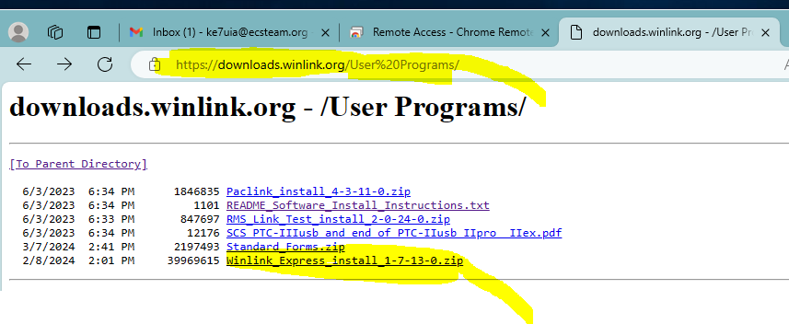
Download.winlink.com
Notes:
Here is the download page for winlink and VARA.

Slide 5
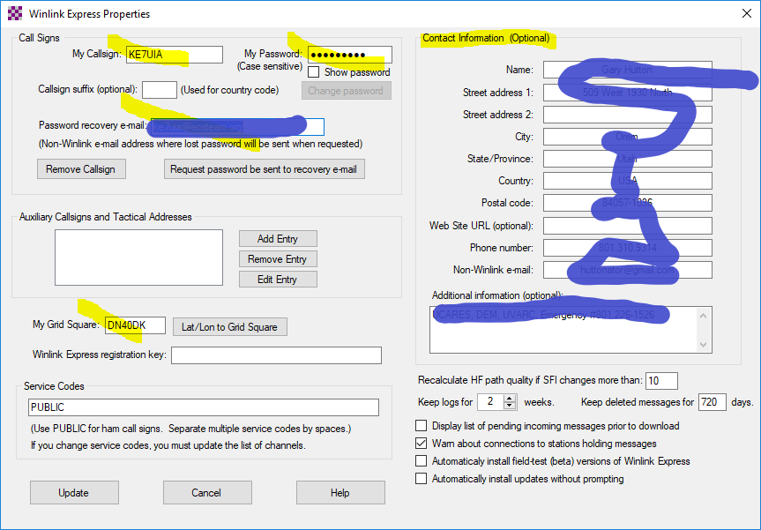
Setup screen
Notes:
Here is the initial setup page and critical items to fill in.

Slide 6
Obtain email address
Read instructions on winlink.org
Youtube.com is your friend
Your winlink email address is just your call sign
Example = ie. ke7uia
Notes:
Your call sign is your winlink email address. It can also be used for tactical addresses.

Slide 7
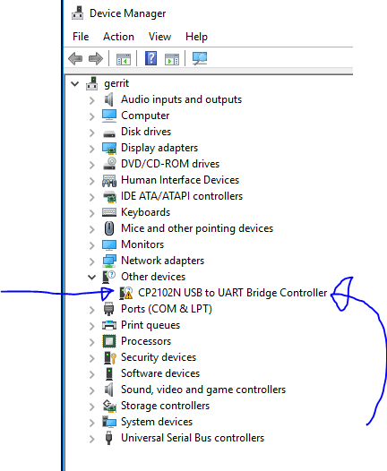
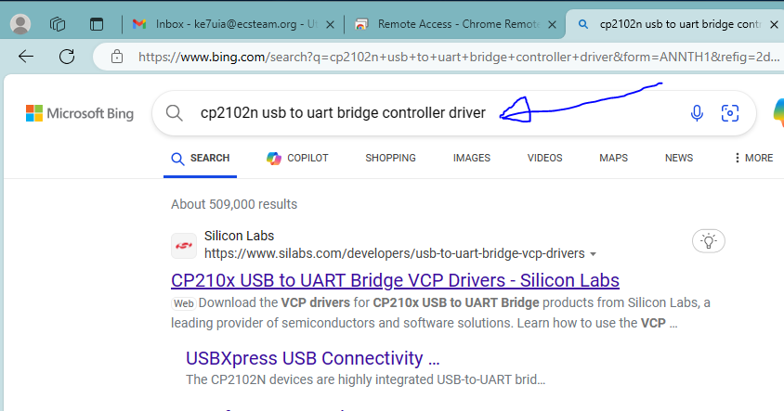
Install Drivers
Notes:
Be familiar with your devices. Check in Device Manager.
Notice if your device has a driver. Then just install one.

Slide 8
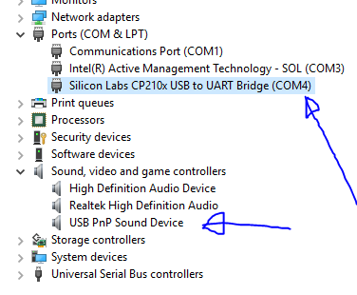
Com Ports
Notes:
After the install the yellow triangle goes away and the com port is identified.
Also the the Sound controller is identified.

Slide 9
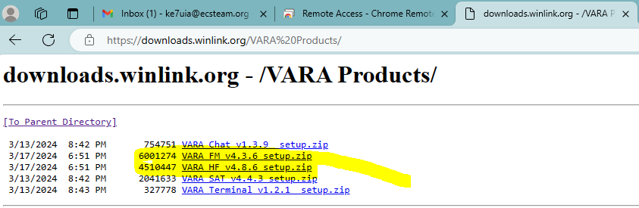
Download VARA FM
Notes:
Now install the VARA modem.

Slide 10
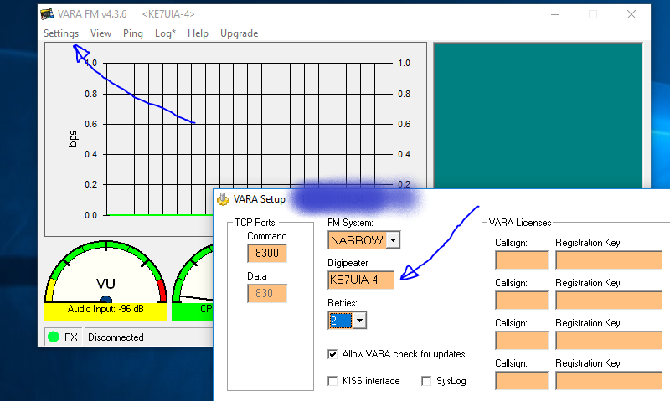
VARA Settings
Notes:
Go to the settings Menu and set all the pointers

Slide 11
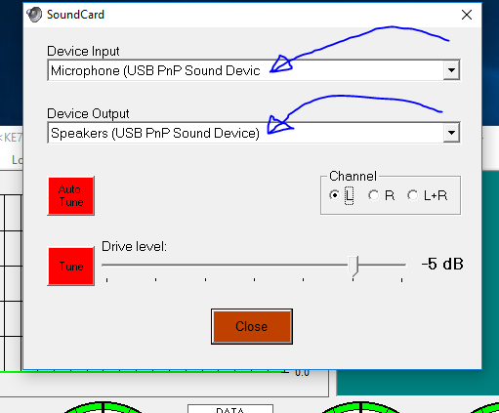
VARA – Sound Card
Notes:
In the settings menu set the pointers to the correct sound controller.

Slide 12
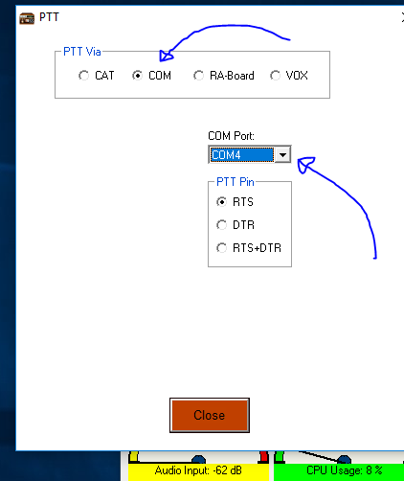
VARA – PTT Port
Notes:
In the settings menu: this is how we use the push to talk button. It is by using the correct com port.

Slide 13
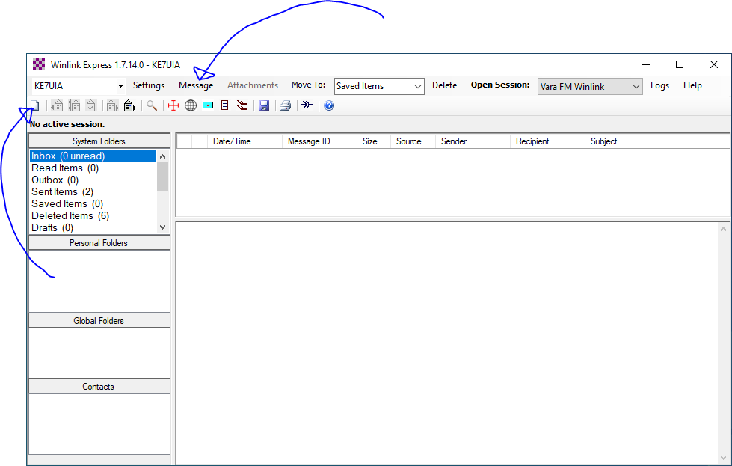
Create Message
Notes:
This is how we create a message. Notice how many items are in the Output box.

Slide 14
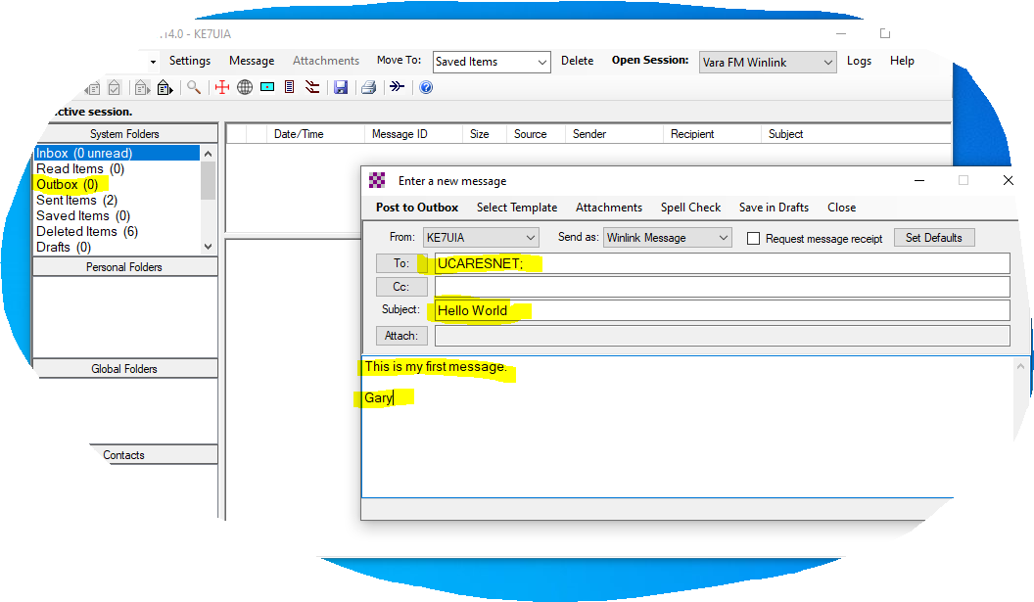
Create Message 2
Notes:
Fill in the To: box.
Fill in the Subject box.
Fill in the Body of the message.
Add attachments if necessary.
You do not want to send big files.
Post the message.
All that happens is a file is created and left in a folder.

Slide 15
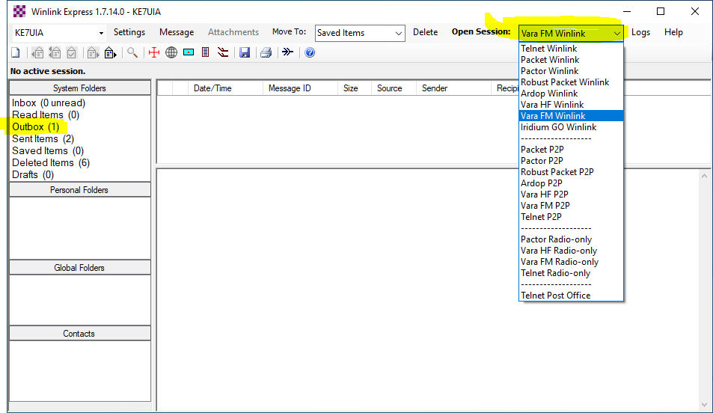
Select Session Type
Notes:
Notice the Output box has increased by one.
Now we decide how to send the message.
Telnet
Ardop
VARA FM
VARA HF,
Etc.

Slide 16
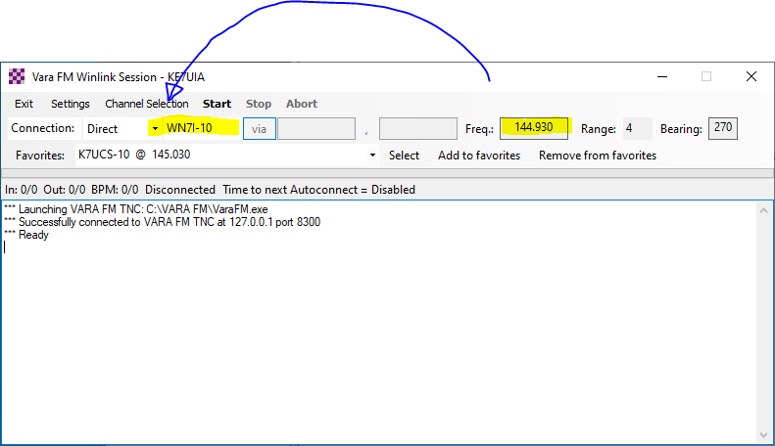
Select Channel
Notes:
Start the session window.
Now select the gateway you want to send to.
Use the Chanel Locator menu.

Slide 17
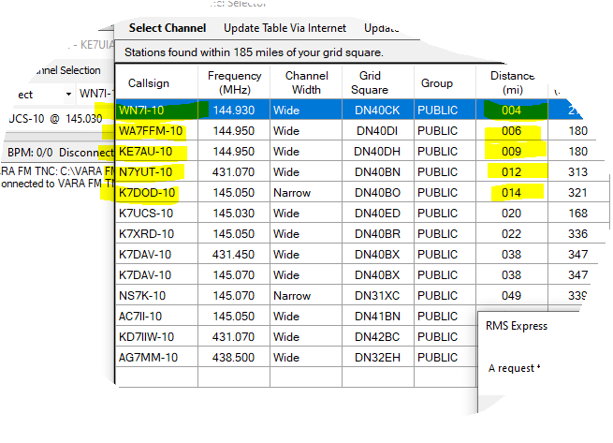
Select Channel 2
Notes:
Choose your favorite gateway.
Remember it might be busy and down. So try another one.

Slide 18
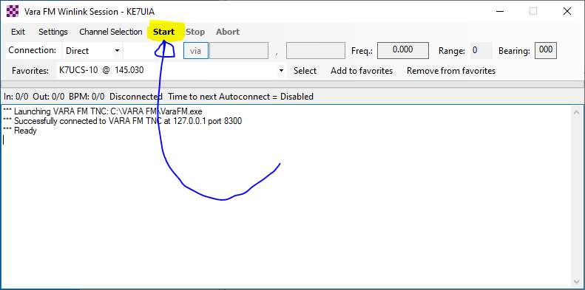
Press Start
Notes:
Press the Start button and read the screen.

